Slide 1
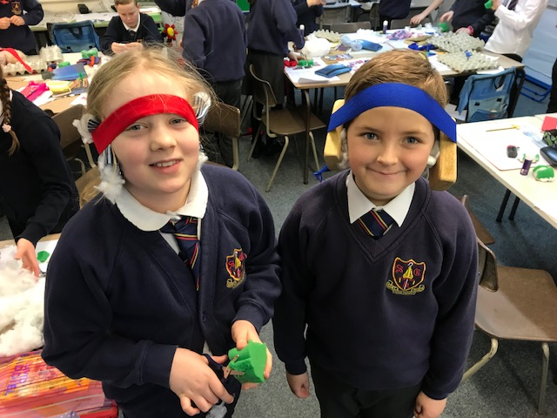
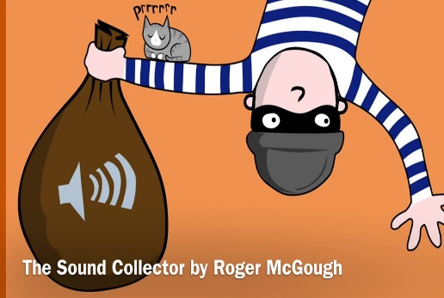
Big Question: Is it possible to drown out Mr Logan’s noise? |  |  | Exciting Books
LQ1 | What is that noise?
LQ 2 | Does noise travel in a taxi?
LQ 3 | How did I hear that?
LQ 4 | How did I hear that? (part 2) | Sticky Knowledge about Sound. | Key Vocabulary
 |  |  | Sound, listen, hear, ears, noise, loud, quiet, silent, vibrations, vibrate, investigation, fair-test, factor (variable), prediction, results, resources, planning, muffle, vibrations, sound waves, sign language. transmit, medium, air, water, solid, source, particles, travel, vacuum, frequency
LQ 5 | What materials can block or muffle sound? | Sound travels with a speed of 767 miles per hour.
LQ 6 | Can you sell your ear defenders to a panel? | Sound comes from vibrations. These vibrations create sound waves which move through mediums such as air and water before reaching our ears.
End Product | A set of ear defenders and a communication line. | Our ears vibrate in a similar way to the original source of the vibration, allowing us to hear many different sounds.
Links to previous topics | KS 1 look at senses. | When traveling through water, sound moves four times faster than when it travels through air.
 | It links to the Charanga music scheme. | Sound is used by many animals to detect danger, warning them of possible attacks before they happen.
 |  | Dogs can hear at a higher frequency as compared to humans.
CURRICULUM links: | Literacy and The Sound Collector. DT and making ear defenders.
 |  | The loud noise you create by cracking a whip occurs because the tip is moving so fast it breaks the speed of sound!

